Slide 1
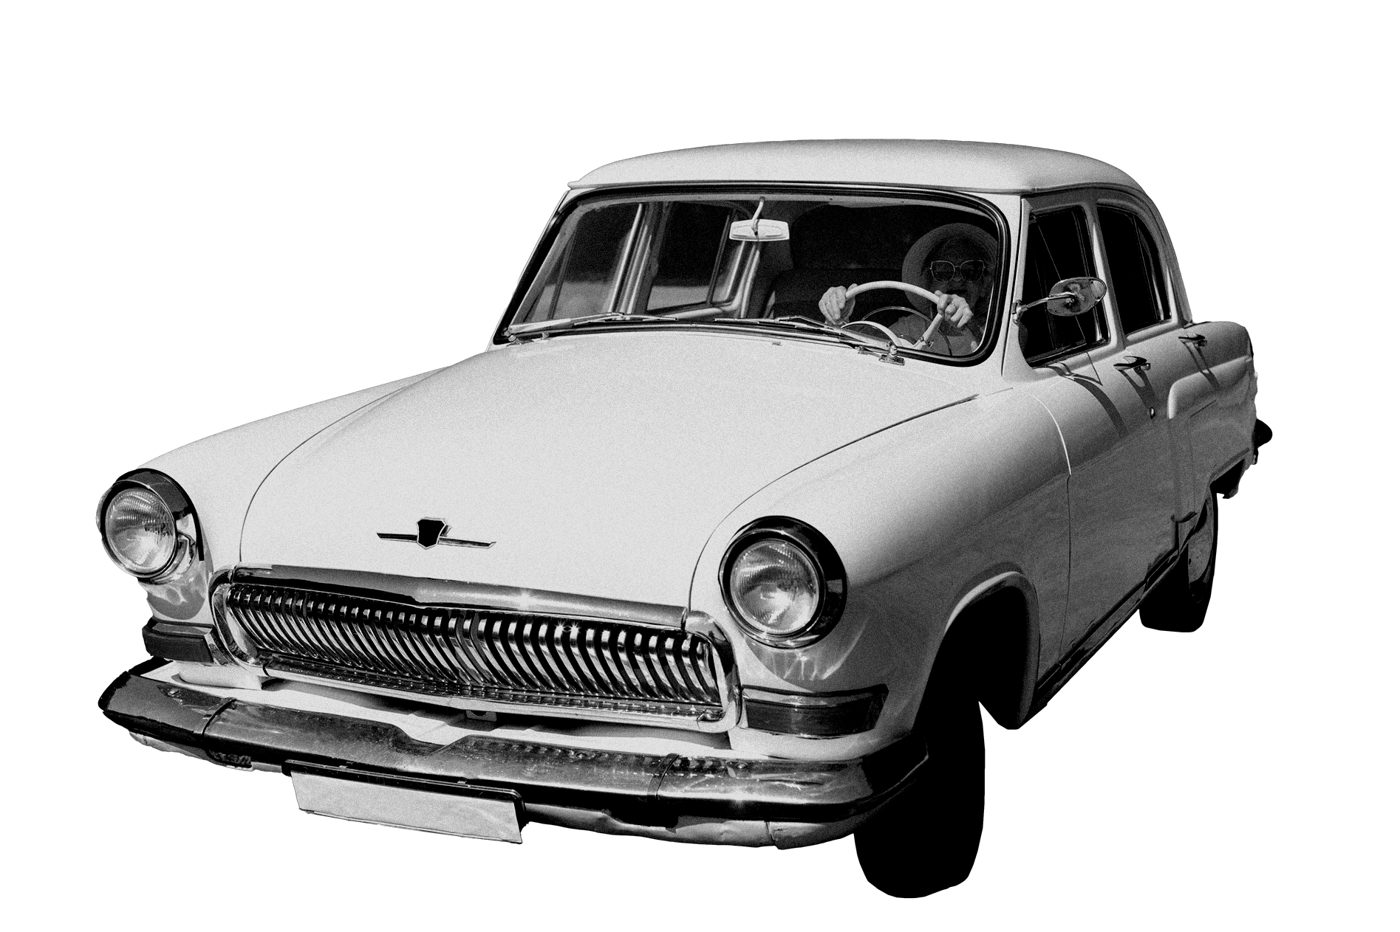
Automotive Market

Slide 2
Table of contents
01.
02.
03.
Introduction
Historical Overview
Current State of the Market
04.
05.
Trends and Challenges
Opportunities for Growth

Slide 3
Introduction
The German used car market is one of the largest and most dynamic markets in the world. With millions of cars sold every year, it is a key driver of the German economy and an important source of employment for thousands of people.
Automotive

Slide 4
Historical Overview
Industry
Maintenance
Safety
The German car market has a long and rich history, dating back to the early days of the automobile industry. Over the years, it has grown and evolved, adapting to changing consumer needs and technological advancements.

Slide 5
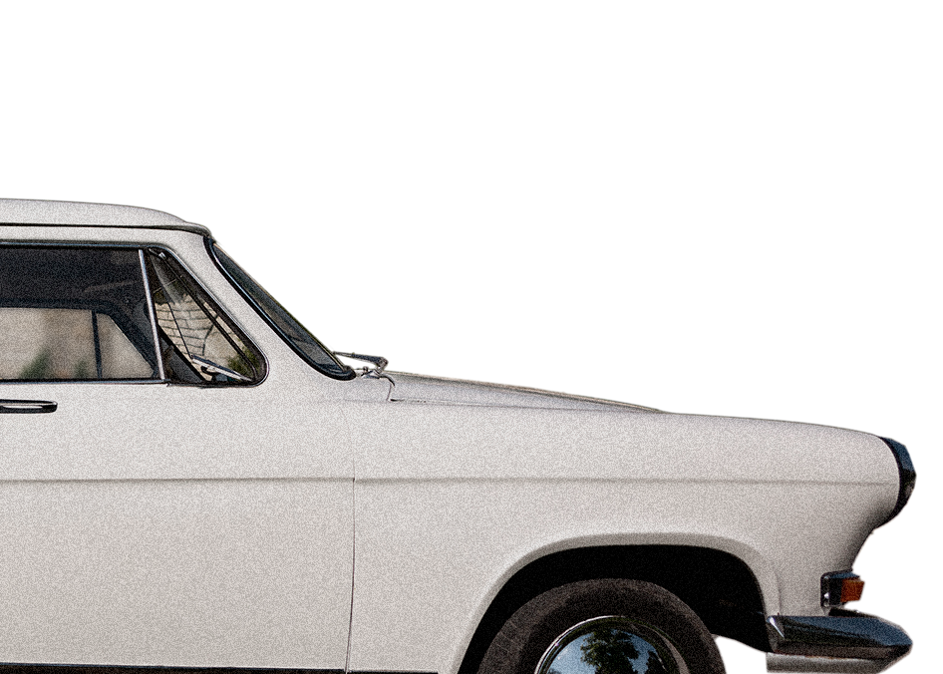
Current State of the Market
Today, the German used car market is a vibrant and competitive industry, with a wide range of players offering a diverse array of products and services. From traditional dealerships to online platforms, there are many ways to buy and sell used cars in Germany.

Slide 6
Trends and Challenges
Despite its many strengths, the German used car market faces a number of challenges in the years ahead. These include changing
consumer preferences
increased competition from new players
the ongoing impact of COVID-19 on the economy.

Slide 7
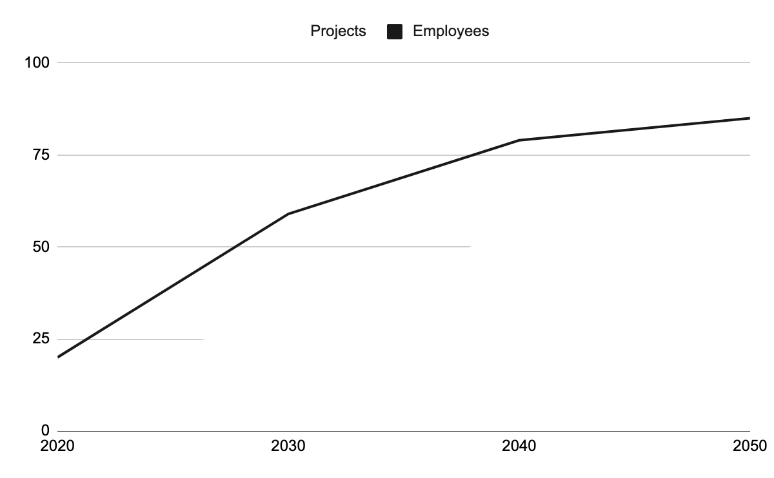
Opportunities for Growth
75%
50%
Despite these challenges, there are many opportunities for growth in the German used car market. By embracing new technologies, developing innovative business models, and focusing on customer needs, companies can position themselves for success in this dynamic and exciting industry.

Slide 8
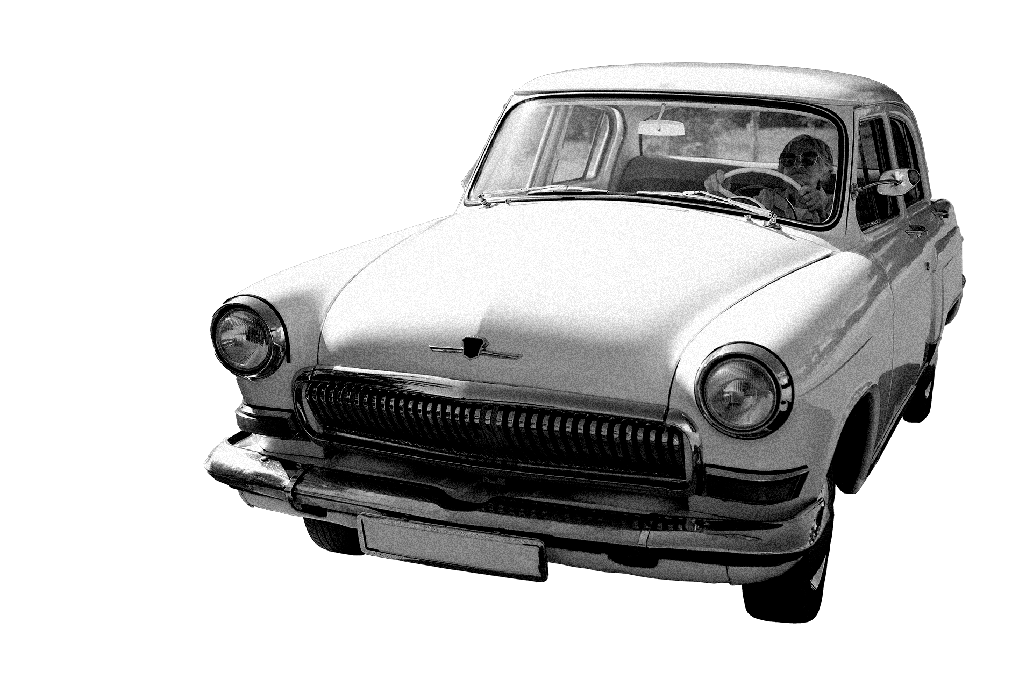
Thank you!
Kyrillos Tadros
Please keep this slide for attribution

